Slide 1
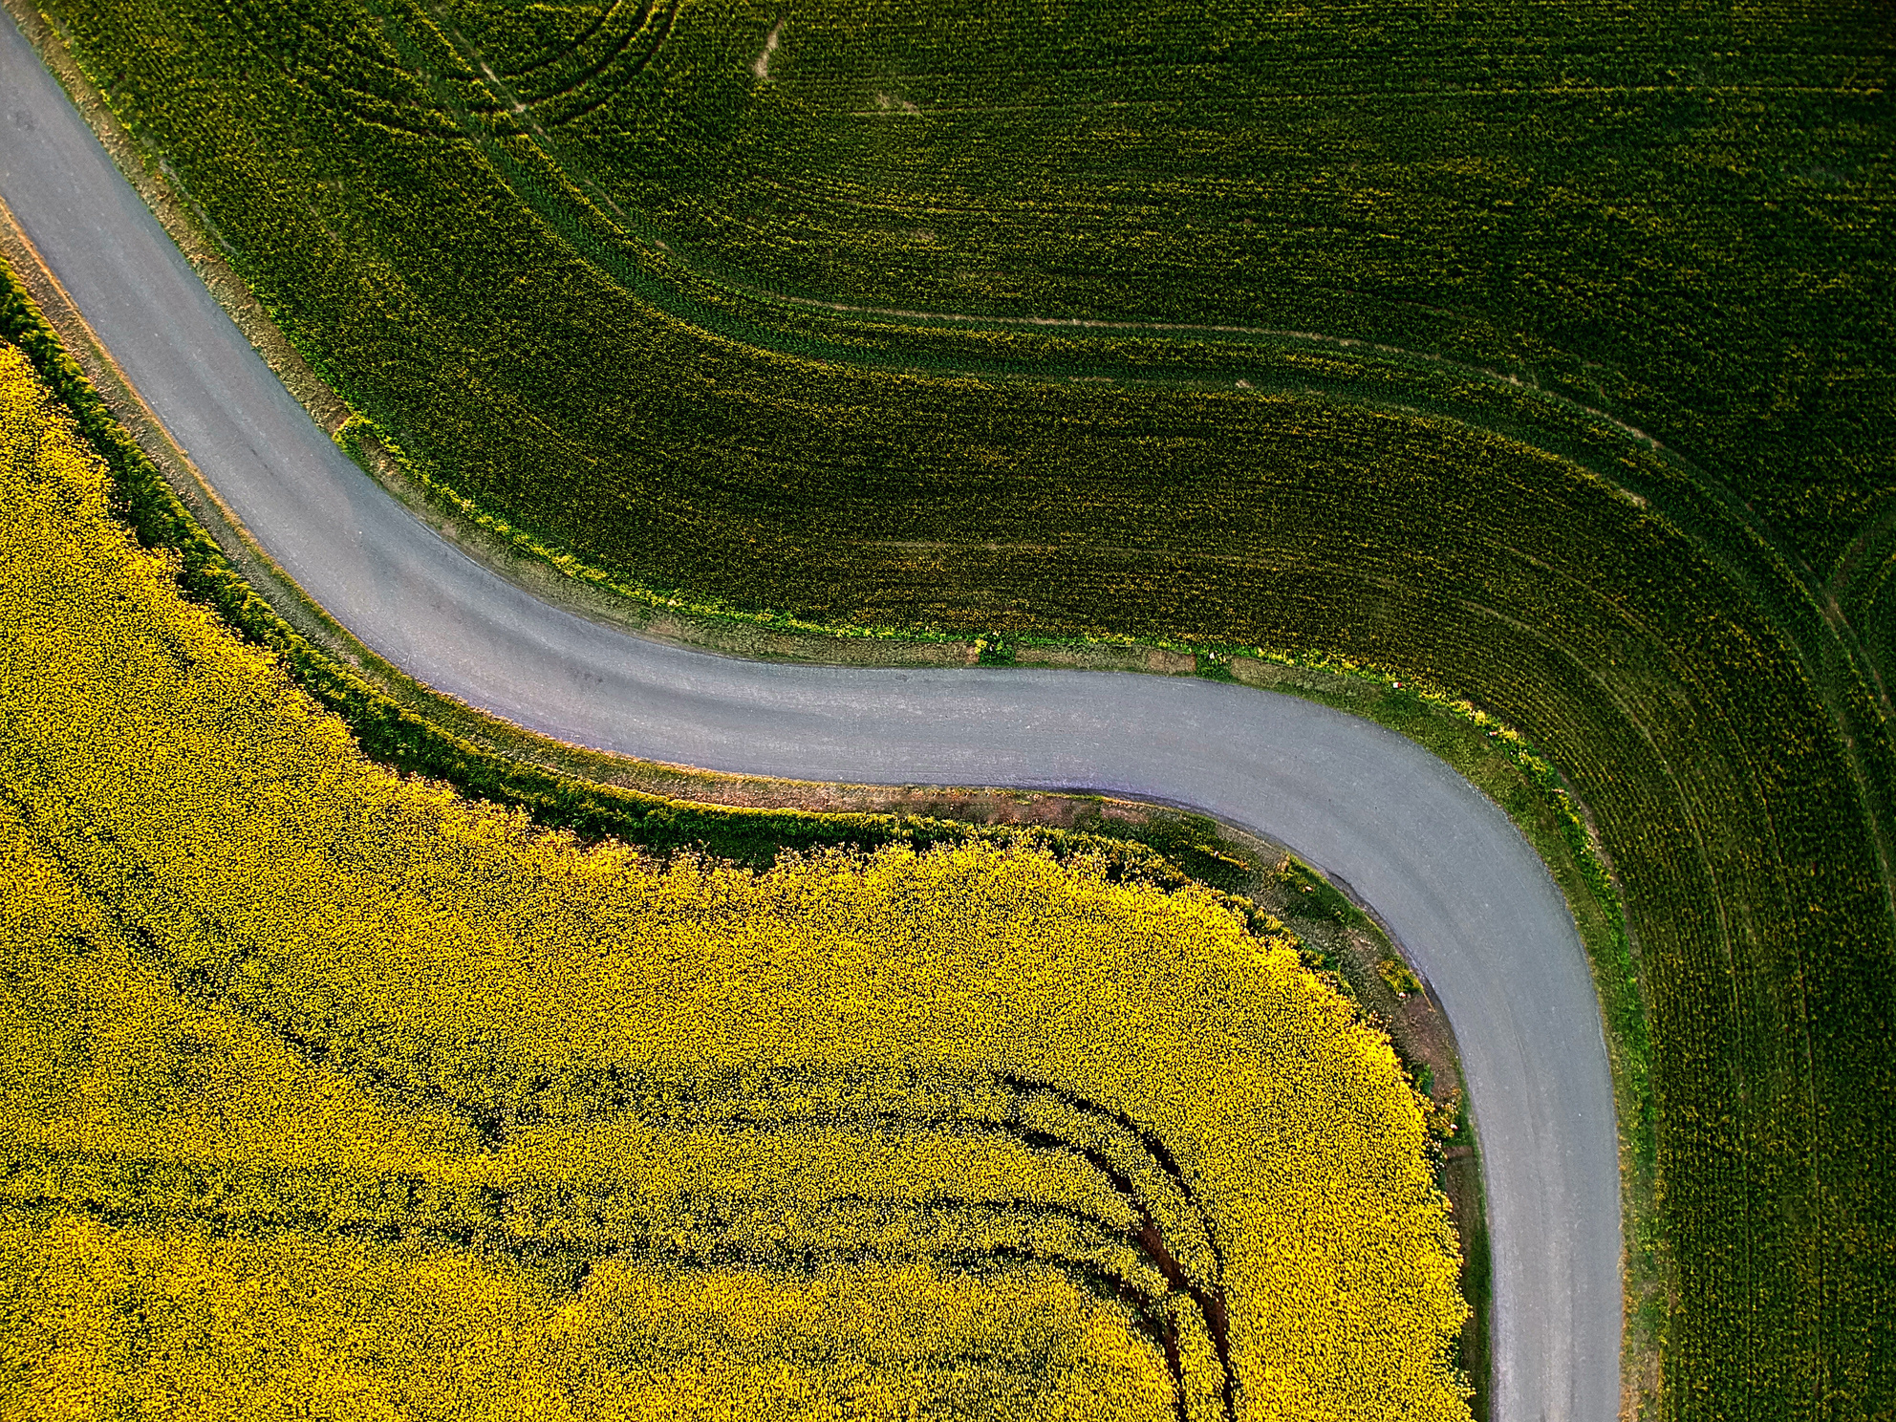
CROP RECOMMENDATION
Mentor : Dr. Pradeep Balaji
Presented by : K Jayasurya, K Hrithik Raj,K Abhiram,
L Karthikeya Reddy

Slide 2
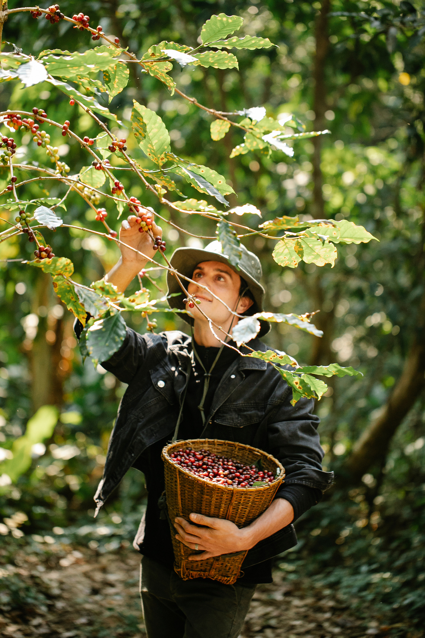
Problem Statement:
IoT based Smart Farming improves the entire Agriculture system by monitoring the field in real-time. It keeps various factors like humidity, temperature, soil etc. under check and gives a crystalclear real-time observation. Machine learning in agriculture is used to improve the productivity and quality of the crops in the agriculture sector.
A farmer’s decision about which crop to grow is generally clouded by his intuition and other irrelevant factors like making instant profits, lack of awareness about market demand, overestimating a soil’s potential to support a particular crop and so on.
After examining the current traditional crop recommendation techniques we found that they are very time consuming. so, we came up with predictive ML model which suggests the crop based upon the data collected from farm using sensors.

Slide 3
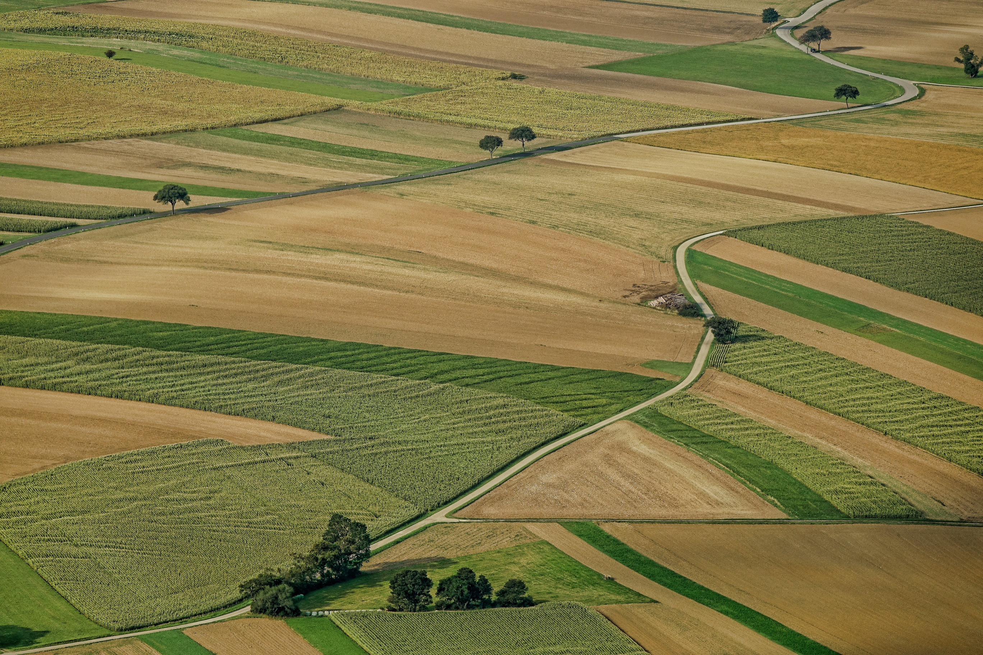
Progress

Slide 4
Current solutions for the problem:
A farmer’s decision about which crop to grow is generally clouded by his intuition and other irrelevant factors like making instant profits, lack of awareness about market demand, overestimating a soil’s potential to support a particular crop and so on.

Slide 5
Current state of the project:
We Acquired the dataset from open source platform kaggle .
We Preprocessed the data which involved data cleaning , feature selection etc...
We Found out really useful insights from pre processed data.
We Trained ML Model using the preprocessed data.
We used random forest classifier ML Algorithm to train model.
We Created a Website with help of Streamlit.
We inserted Trained ML Model into the Website.

Slide 6
Novelty:
Incorporating novel approaches such as advanced ML algorithms, multiple data sources, real-time data, personalization, and integration with other agricultural systems can help to improve the effectiveness and accuracy of crop recommendation systems, and ultimately benefit farmers and the agriculture industry as a whole.
Feasibility:
Crop recommendation systems using ML have been successfully developed and implemented in various regions around the world. These systems have the potential to help farmers make better decisions about crop selection and management, improve crop yields, and increase profitability. The feasibility of a crop recommendation system depends on the availability of data, resources, and expertise, but with proper planning and execution, it can be a valuable tool for the agriculture industry.

Slide 7
Proposed Solution:
In this project, we use ML algorithms and IoT to recommend a crop to plant on a farm. In the IoT part, we use different types of sensors like Ph sensors, Temperature sensors, and Humidity sensors at that particular time.
The Client enters the values shown by the sensors on the website. Now comes the ML part, based on the location of the farm we get the NPK values from the previous data set and we combine the values of the temperature, humidity, Ph, and NPK values to get the best suitable crop for the soil.

Slide 8
SURVEY:
We interacted with our teammate's relatives. Who have been farmers for a long time. Based on our interactions. we found that most of them were sowing the same pattern of crops for a long time. majority of them do not know that crop recommendation exists.
They are unaware of the crop prices in the market. Even though some of them are aware of soil testing methods they are hesitant to use soil testing techniques because they are time taking and costly. Clients suggested providing something which is very easy to interact with, cost-effective, and has immediate output.

Slide 9
Project requisite:
Data Collection
Data Preprocessing
Machine Learning Algorithm
Training and Testing
Model Selection
Deployment
Integration with IoT Device

